Slide 1


RAJIV GANDHI UNIVERSITY OF KNOWLEDGE AND TECHNOLOGIES-SRIKAKULAM DEPARTEMENT OF ELECTRONICS AND COMMUNICATION ENGINEERING
Mini Project Batch-28
AUTONOMOUS FIRE FIGHTING ROBOT USING ARDUINO
GROUP MEMBERS:
M Sirisha (S191059)
M Chandra Rao (S190534)
D Sai Jagadeesh (S190023)
K Radha Rani (S190145)
K Yamuna (S190768)
N Mounika (S190823)
PROJECT GUIDE :
Y.Lakshmi Prasanna ,M.Tech
Asst.Prof
ECE Department

Slide 2
CONTENTS:
Abstract
Introduction
Objective
Components Required
Problem Formulation
Construction
Block Diagram
Working
Circuit Diagram
Literature Review
Advantages, Disadvantages and Applications
Conclusion
References
Future Scope

Slide 3
ABSTRACT
This advanced firefighting robotic system independently detects and extinguishes fire. In the age of technology, the world is slowly turning towards the automated system and self-travelling vehicles, firefighters are constantly at a risk of losing their life. Fire spreads rapidly if it is not controlled. In case of a gas leakage there even may be an explosion. So, in order to overcome this issue, safeguard the lives of our hero, our system comes to the rescue. This firefighting robotic system is powered by Arduino Uno development board it consists of the HC-SR04 ultra-sonic sensor mounted on a servo motor for obstacles detection and free path navigation, it is also equipped with the fire flame sensor for detecting and approaching fire it also makes use of water tank and spray mechanism for extinguishing the fire.
Water spraying nozzle is mounted on the servo motor to cover the maximum area. Water is pumped from the main water tank to the water nozzle with the help of 12Vpump. This water pump needs a driver circuit as it consumes a lot of current, much more than the controller provides.

Slide 4

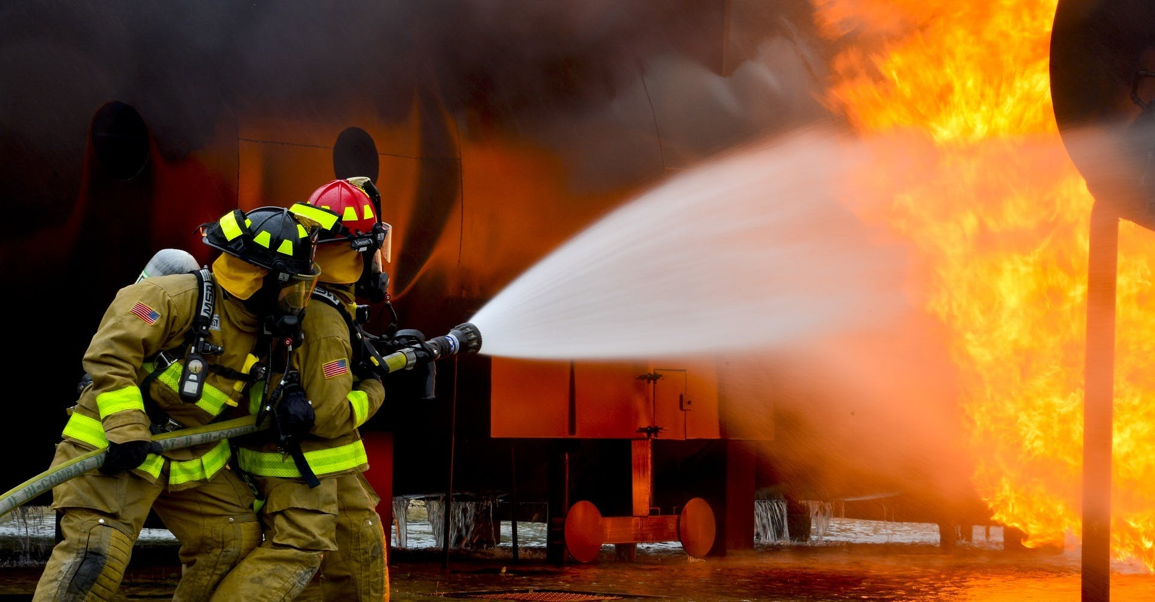
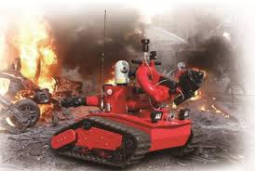
INTRODUCTION
Fire fighter robot can be used to control the fire. This robot can detect the fire by itself and control the fire by throwing water. There are some sensors we are using that can detect fire and robots can move there to fire extinguish. The firefighting robot has the same structure as Bluetooth control RC car.
The robot has 3 sensors 1 sensor at the front side which see if there is anything in front of the robot and the other two at the both front corner which also searches for fire. if any sensor detects fire at any side the robot will sense and move towards it.

Slide 5
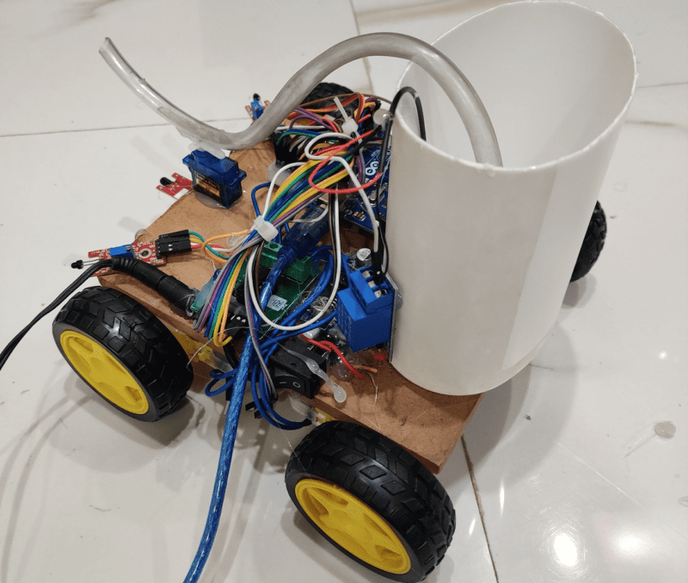
The firefighting robot has 4 wheels, 3 sensors, one water tank, one nozzle, and a computer which help him to take decision according to the Arduino code.
There is only some basic feature when you will start the robot it will move forward first until it gets fired anywhere. if any sensor of the robot will find the flame anywhere it will start moving toward the flame and with the help of the water nozzle of the firefighting robot using Arduino will start watering the particular area.
Fire fighter robot and line follower robot have the same sensor but the working in both conditions are different.

Slide 6
OBJECTIVE
Design and development of low cost firefighting robot.
Run automatically firefighting robot.
Extinguish fire.

Slide 7
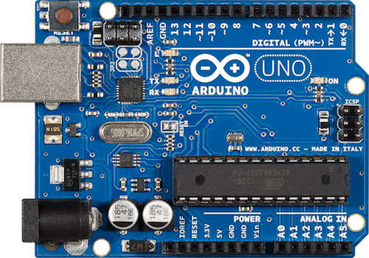
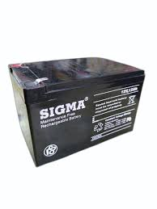
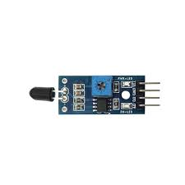
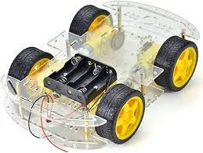
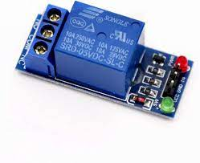
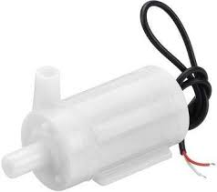
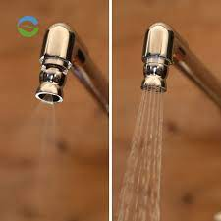
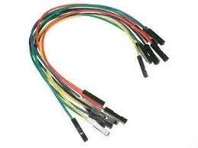
COMPONENTS REQUIRED
1.Arduino UNO
2. 12v Battery
3. Flame IR Sensor
4.Robot Chassis
5.Single Channel Relay
6.Water Pump 5v
7.Nozzle For Water
8.Connecting Wires

Slide 8
PROBLEM FORMULATION
Fire disaster is one of the dangerous problems that can lead to heavy loss both financially and by taking lives. Sometime it becomes difficult for fighters to access the site of a fire because of explosive materials, smoke, and high temperatures. Such situations risk the lives of fire fighters too.
In such environments, fire-fighting robots can be useful. This Fire Extinguishing Robot is based on IOT Technology.
In Fire Extinguishing Robot, we intend to build a system that could extinguish a small flame by sensing and moving to the location itself. Sometimes delay in the arrival of fire fighters leads to numerous consequences.
The Fire Extinguishing robot continuously monitors the environment and extinguishes it without delay.

Slide 9
CONSTRUCTION
Constructing a firefighting robot using Arduino involves several components. Here's a basic overview:
Materials:
Arduino board (e.g., Arduino Uno)
Motor driver module
DC motors and wheels
Chassis for the robot
Ultrasonic sensors for obstacle detection
Infrared (IR) sensors for flame detection
Water pump and reservoir
Fire extinguisher module
Battery for power

Slide 10
Construction Steps:
Chassis Setup:
I. Attach the motors to the chassis and connect them to the motor driver.
II. Mount the wheels securely.
a. Sensor Installation:
i. Place ultrasonic sensors on the front for obstacle avoidance.
ii. Install IR sensors to detect flames.
Motor Driver Connections:
I. Connect the motor driver module to the Arduino, linking it with the motors.
Arduino Wiring:
I. Connect sensors and other modules to the appropriate pins on the Arduino.
Flame Detection Programming:
I. Write code to read data from IR sensors for flame detection.
Motor Control Programming:
I. Write code to control the motors based on sensor inputs.
6. Water Pump and Extinguisher Setup:
Connect the water pump to the Arduino and fill the reservoir.
Integrate a mechanism to trigger the fire extinguisher module.
7. Testing:
Test the robot in a controlled environment to ensure sensors and actuators work correctly.

Slide 11
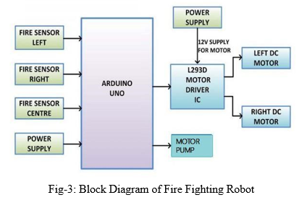

BLOCK DIAGRAM

Slide 12
WORKING
So, there in the working of Fire fighter robot we are providing the algorithm first so you can have the idea about the basic working of the robot. There are we are using 3 IR flame sensor which are continuously seeking for fire or flame. The IR Flame sensor sense the warm and heat from anybody. and we coded this sensor that it can sense the flame around it. All three sensor always searching for fire. if any of the sensor will find it. the robot will turn and start walking toward the fire.
How does it work?
The flame sensor sense the fire and send the information to the Arduino which is the brain of this robot. The brain will take the action according to the condition and information getting from the sensor. Arduino will give the commands to the Motors to start in the walk in the desired direction. if left sensor give the information about the fire then the Arduino will run the motor in left direction. same for the front and right side motor.​The robot will stop near to the fire and start watering to it till the fire will be under control.

Slide 13
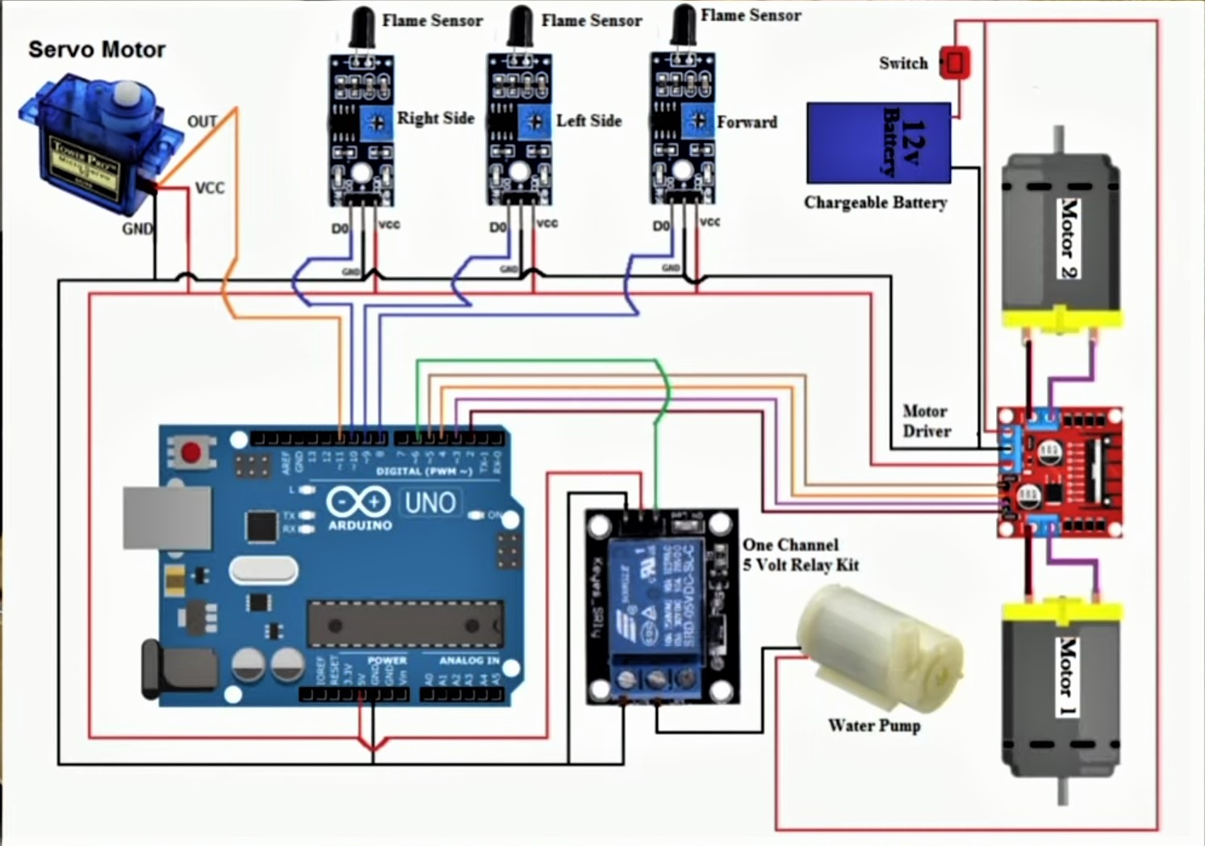
CIRCUIT DIAGRAM
Make all the connection as the given in the circuit diagram.
After completing the Connection next step is to write the code and program for our project.

Slide 14
LITERATURE REVIEW
L
S.NO | TITLE | JOUR -NAL | ADVANTAGES | DISADVANTAGE -S
1. | An Autonomous Firefighting Robot | IEEE(2015) | Traversing a map -Wall following -Obstacle avoidance 2) Providing external communications -Live camera Feed -Map representation via Bluetooth | Data rate transmission is lower than wired transmission High cost
2. | Automatic Fire Extinguisher Robot | IEEE(2011) | It is coated with calcium silicate which have capability to withstand in high temperature. Robot turn on automatically as it datects the fire surrounding it. | Robot will not work until it cut-off temperature which was set to make it sensitive and resistant.

Slide 15
S.NO | TITLE | JOUR -NAL | ADVANTAGES | DISADVANTAGES
3. | Fire-Fighting Robot | IEEE (2016) | 1)Battery is mounted inside The robot. | 1)It don't have any mail system. 2)The flame sensor threshold value need to be manually obtain.
4. | An Autonomous Fire ExtinguisherRobot | IEEE (2015) | 1)Lightweight. 2) Low current consumption. 3)Heat resistant because of aluminium body. | 1)Aluminium is expensive.
5. | Development of fire fighting robot (Qrob) | IJACSA (2019) | 1)Human can monitor robot by using camera which connects to smartphone or remote device. 2)Increase safety, productivity, efficiency & quality of task given. | 1)High cost because acrylic plate is used.

Slide 16
ADVANTAGES
.
Reduce Human Effort
.
To Detect The Exact Direction Of The Fire Source
.
Reliable And Economical
DISADVANTAGES
.
.
Limited Battery life
Difficulty In Complex Terrains
.
High Cost Of Production
APPLICATIONS
Fire fighter robot can be used in the area where we can’t go.
Fire fighter robot use in war.
Fire fighter robot can be used at big kitchen.
Fire fighter robot can be used it Restaurant.

Slide 17
EXPECTED RESULTS
Accidents caused by fire can result in significant injury and property loss. This paper presents fire detection and extinguishment using autonomous robot, as well as a complete assessment of several fire-fighting robots.
This will undoubtedly result in a better system for monitoring water quality, and the water resources can be rendered safe by fast action. Despite the fact that there has been numerous good fire- fighting devices, the research topic remains tough. This paper provides an overview of current research efforts by researchers to make fire-fighting robots smarter, less expensive and more efficient.

Slide 18
FUTURE SCOPE
The aim in future would be to implement this system and its principle on a Humanoid Robot to avoid human loss during vast fire accidents and wars, where the human rescue operations cannot be performed.

Slide 19
CONCLUSION
Fire Fighting Robot continuously monitors the temperature at three sensors
And if fire accident is true, the robot moves to the direction to which the temperature is recorded to be relatively maximum among the three sensors and extinguishes the fire with water pump provided to it.

Slide 20
REFERENCES
1.
Thermoelectric materials for Thermocouples, University of Cambridge, [online] Available: www.msm.cam.ac.uk/utc/thermocouple/pages/ThermocouplesOperatingPrinciples.html.
2.
Thermocouple National Instruments, [online] Available: zone.ni.com/devzone/cda/tut/p/id/4237
3.
Thermocouple or Temperature Sensor Bucknell, [online] Available: www.facstaff.bucknell.edu/mastascu/elessonshtml/Sensors/TempThermCp1.html.
4.
Non-Inverting Amplifier using IC 741, [online] Available: jamia-physics.net/lecnotes/lab/opamp.pdf.
5.
Ramakanth. A. Gayakwad, Comparator and Amplifier using IC 741 Op-amps And Linear IC's.

Slide 21


